Slide 1
Music Through Photos
Speaking Activity

Slide 2
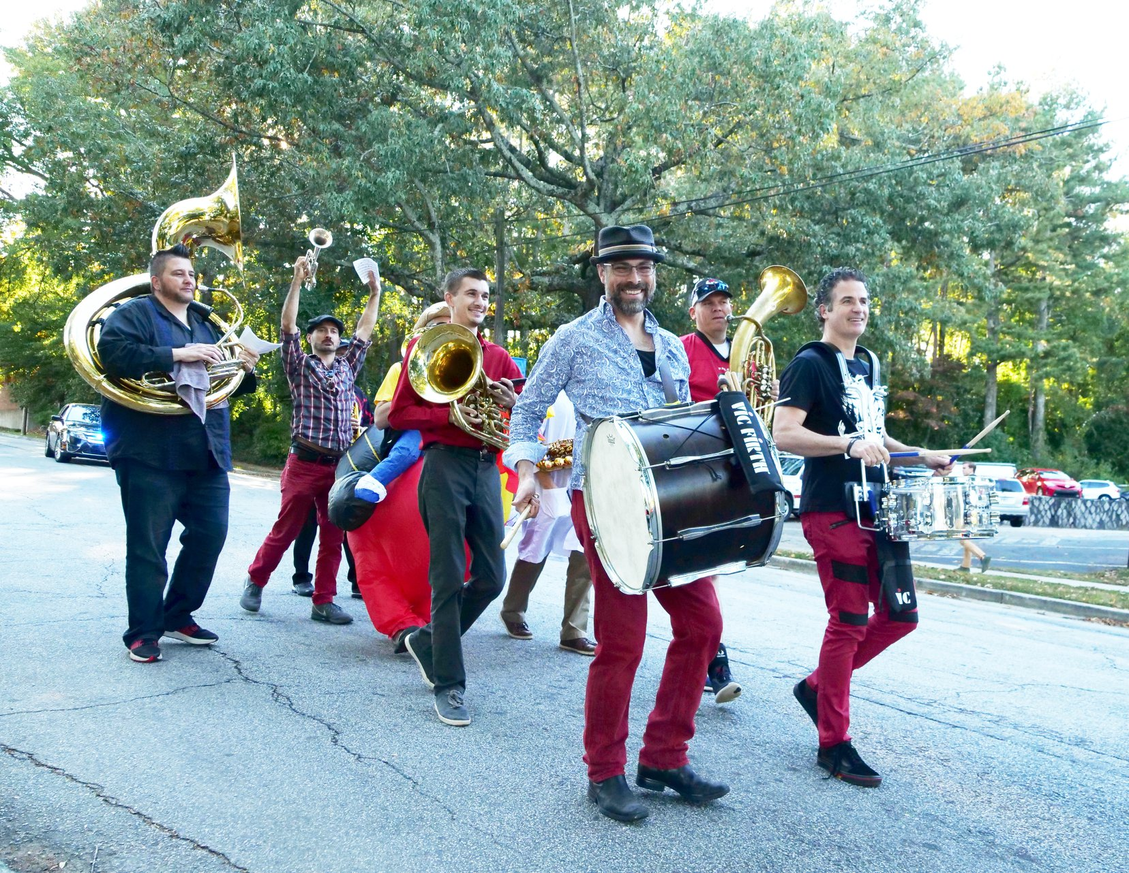
Tips When Describing Photos
Introducing the photo
Describing location
Describing people
Talking about the possibility and certainty

Slide 3
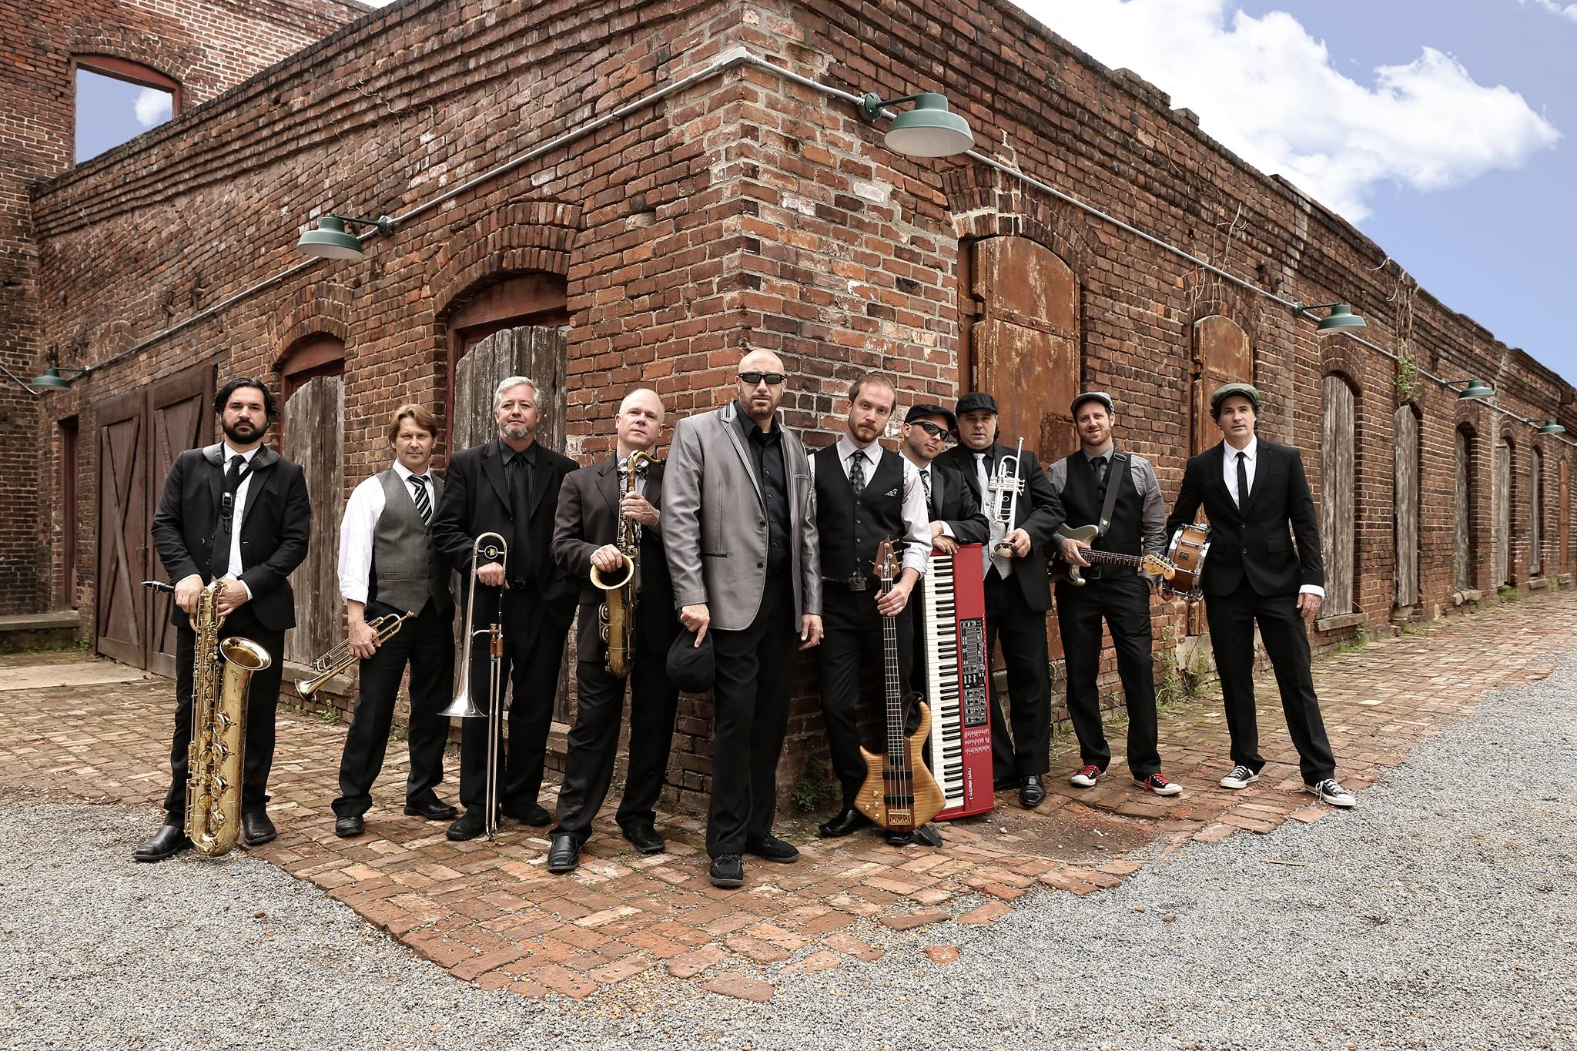
Phase Bank Suggestions
I can see…
There’s a young girl…
There are a group of/ some/ a few people…
The man with a hat/ beard/ T-shirt…
The woman on the left/ right/ in the center…
I think they’re at/ in…
They might have taken the photo because…

Slide 4

Describe What You See

Slide 5
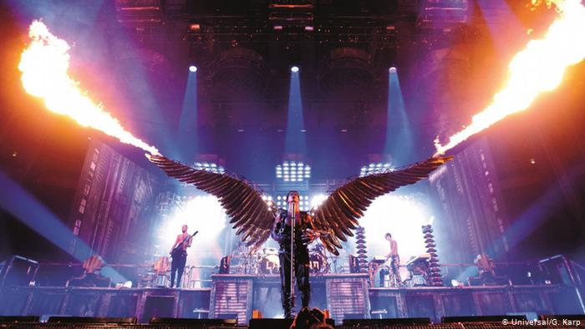
Describe What You See

Slide 6
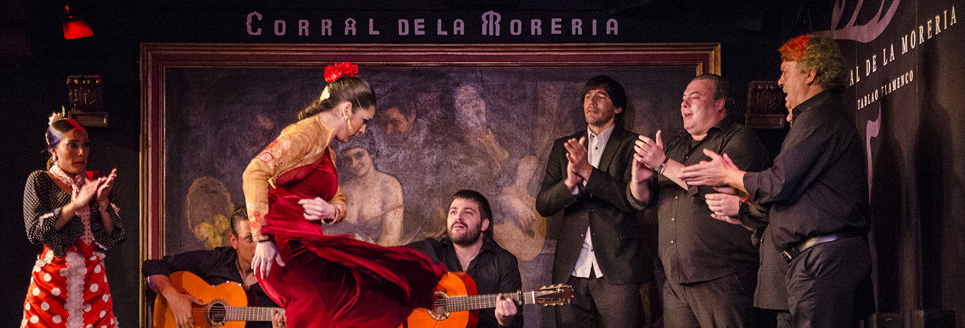
Describe What You See

Slide 7
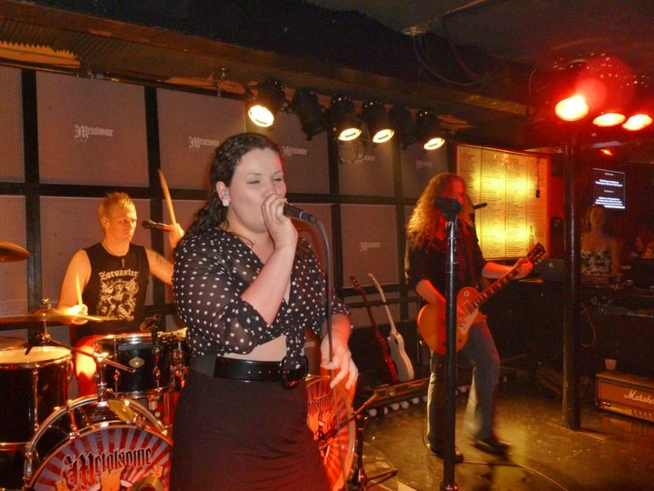
Describe What You See

Slide 8
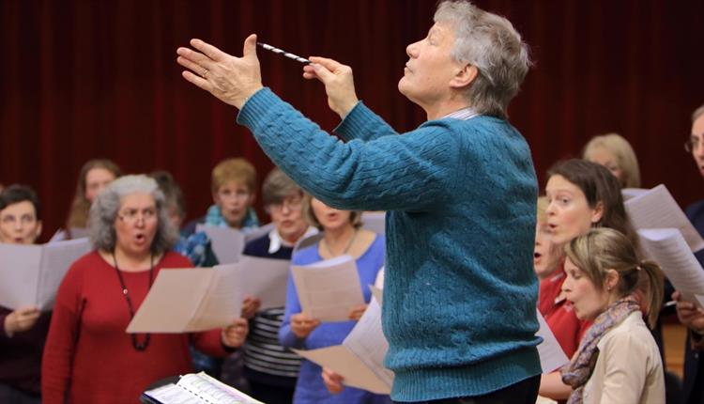
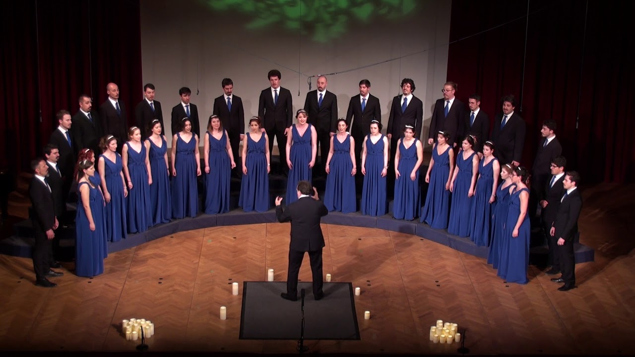
Similar Yet Different

Slide 9
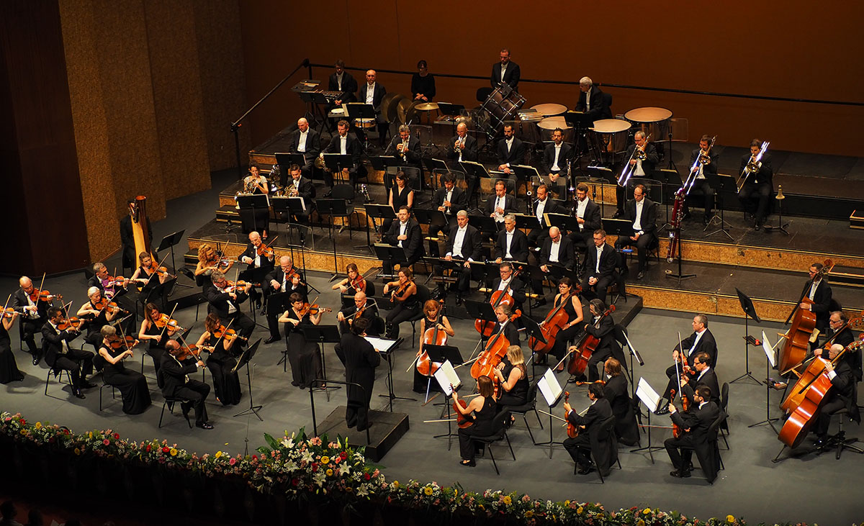
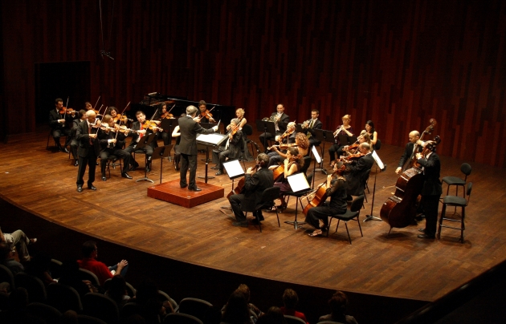
Similar Yet Different

